Slide 1
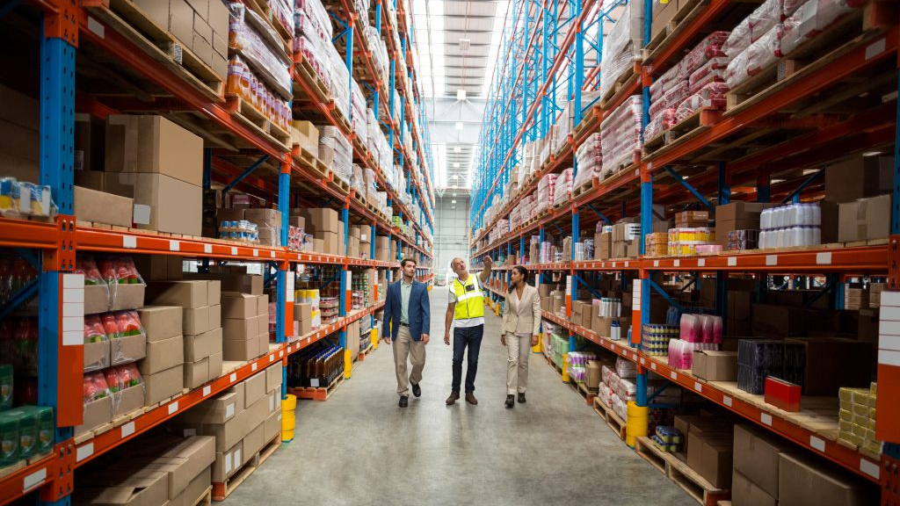
Fresh Food Now Facility Design
IEM 5203 – Oklahoma State University
Samantha Huckabay, Seng Hooi Lim
Abhimanyu Sah, Devarshi Tharwala

Slide 2
EXECUTIVE SUMMARY
Fresh Food Now is a large food vendor in Atlanta, GA with a 160,000 sq. Ft. Warehouse
Current facility is at maximum capacity with 90-95% occupancy
FFN wishes to extend capacity by adding a second facility
FFN carries over 1,000 inventory storage keeping units (SKU)
165,724 pallets to be considered for storage stacking 5 pallets high.
33,145 pallet positions including rack storage and bulk storage.

Slide 3
PROBLEM INTRODUCTION
FFN has now reached its capacity
Operations are not running efficiently
Little bandwidth to accommodate customers
Direct-to-shipments gaining popularity but with low revenue margins

Slide 4
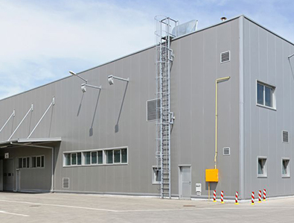
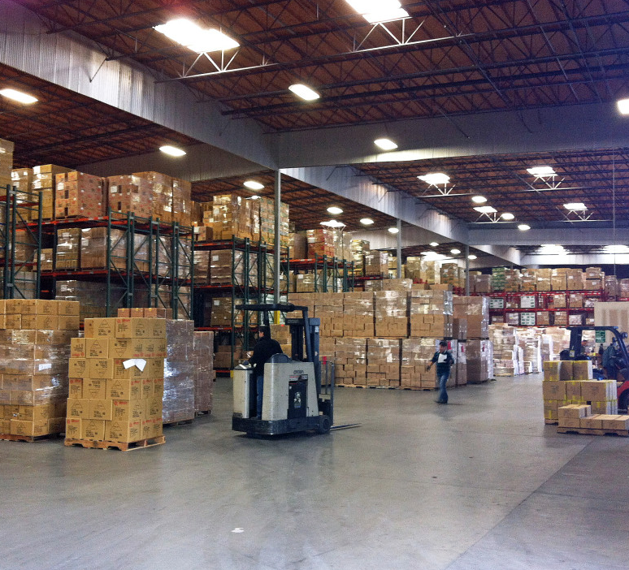
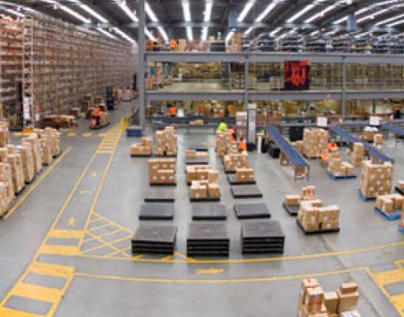
Statement of Scope
Design the layout of the new warehouse
1
Design the operational processes of the new warehouse
2
Justify cost for the new warehouse
3

Slide 5
MAJOR ASSUMPTIONS
For the stack storage, we considered 5 pallet height storage
Top 2% of the slow-moving product is decided to be stored in Bulk storage
Ranked products by calculated average yearly demand

Slide 6
Current processes

Slide 7
OPERATIONS & TEMPERATURE
Commodity | Temperature Constraints
Dry Stock | None
Perishable | 35 – 42°F
Alcohol | 60 - 70°F
Miscellaneous | < 80°F
Consists of approximately 100 employees
Operates 24 hours a day and 7 days a week

Slide 8
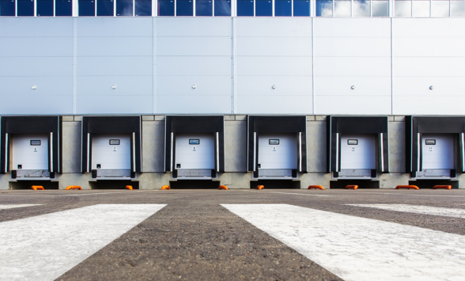
INBOUND PROCESSES
Single-SKU full pallets
Validations and traceability indicators
Direct to primary location or to reserve location
Standing orders
Current inventory level

Slide 9
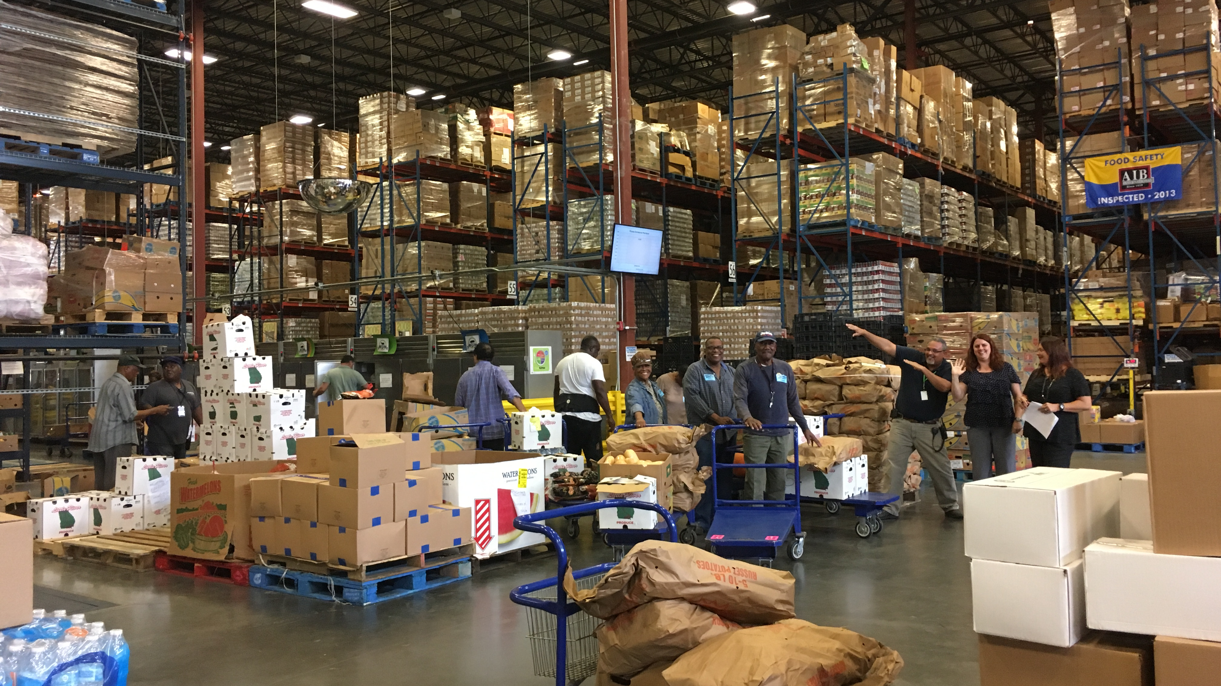
FOOD SAFETY OF PERISHABLE PRODUCTS
FOOD SAFETY OF PERISHABLE PRODUCTS
Ready-to-eat fresh products
Raw eggs/fish
Unwashed fresh products
Raw beef/pork
Raw poultry

Slide 10

ORDER FULFILMENT
Processed via pick-to-voice and launched as soon as received
Almost all orders picked by case
Alcohol has large volumes of unit picks

Slide 11
DESIGN CRITERIA AND OPERATIONAL CONSIDERATIONS
From the old warehouse, 20% slow moving products transferred to direct to store.
Estimated to be 959 pallets for 2024.
One side of the warehouse is 310 foot due to road laws.
All the loading and unloading docks located on this side.
Given pallet size 48" X 40" X 6 feet high and weight capacity:
1600 lbs for the rack storage
2600 lbs for the floor storage.

Slide 12
DESIGN CRITERIA AND OPERATIONAL CONSIDERATIONS
Average inventory for the pallets to be stored:
total order quantity (Q) / 2.
Pallets could be stacked up to 30 feet high (5 pallets high)
Design of the warehouse is considered to be for 2024 and every pallets and storage calculations are based on this year. (Increased by 5.5% annually)
Possibility of future expansion up to 2034

Slide 13
ANALYSIS
New warehouse has 3 class-based storage areas: Dry stock Goods, Perishable Goods and Alcohol and Miscellaneous (Misc) Goods.
9 products transferred from warehouse inventory to cross-docking.
8 were from perishable commodity
1 from dry stock commodity.
The total number of pallets required to be stored for 2015 was 106,750 for the whole warehouse and the estimated number of pallets required in 2024 is 165,724 excluding 20% of the products moved to direct to store

Slide 14
PERISHABLE GOODS ANALYSIS
Estimated randomized storage requirement: 13,434 pallets.
01
Top 2% of slow moving products stored in Bulk storage away from the Loading-Unloading docks. For this the total number of pallets is 231.
02
Considering the stack height of 5 pallets, the total pallets for stack storage is 13,203 pallets.
03

Slide 15
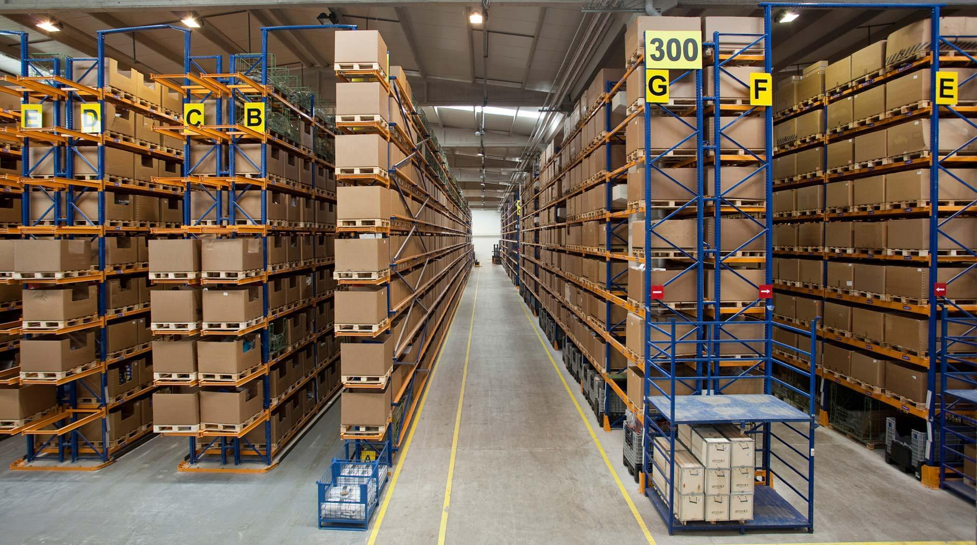
PERISHABLE GOODS ANALYSIS
PERISHABLE GOODS ANALYSIS
2,220 for Ready-to-eat fresh products
420 for Raw eggs/fish
6,365 for Raw beef/pork
1,850 for Raw poultry
2,579 for Unwashed fresh products

Slide 16
DRY STOCK ANALYSIS
Estimated randomized storage requirement: 32,259 pallets.
Top 2% of slow-moving products stored in Bulk storage away from the Loading-Unloading docks. For this the total number of pallets is 648.
Considering the stack height of 5 pallets, the total pallets for stack storage is 32,479 pallets.
Dry stock commodity comprises 70% of the total warehouse area.

Slide 17
ALCOHOL AND MISC. ANALYSIS
Estimated randomized storage requirement: 5,792 pallets.
Top 2% of Alcohol slow moving products stored in Bulk storage away from the Loading-Unloading docks. For this the total number of pallets is 78.
Storage requirement for Misc commodity is comparably less.
Only stack storage.
Considering the stack height of 5 pallets, the total pallets for stack storage is 5,675 pallets.

Slide 18

CHANGES TO LAYOUT
Total area of new warehouse ~ 350,000 sq. ft
Road regulations dicated location of loading docks
32 docks for loading and unloading
Staging area for Alcohol and Misc., Perishable and Drystock goods are 4,200, 7,000 and 9,800 sq. ft, respectively.
Rack Storage area for Alcohol and Misc., Perishable and Drystock goods are 15,652, 36,236 and 88,245 square foot.

Slide 19
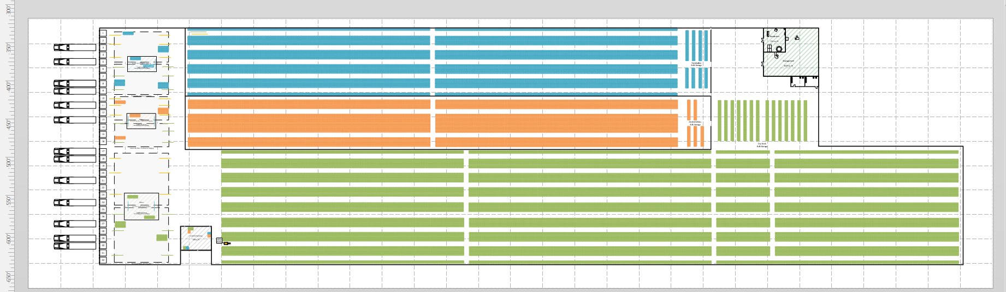
NEW OVERALL LAYOUT

Slide 20
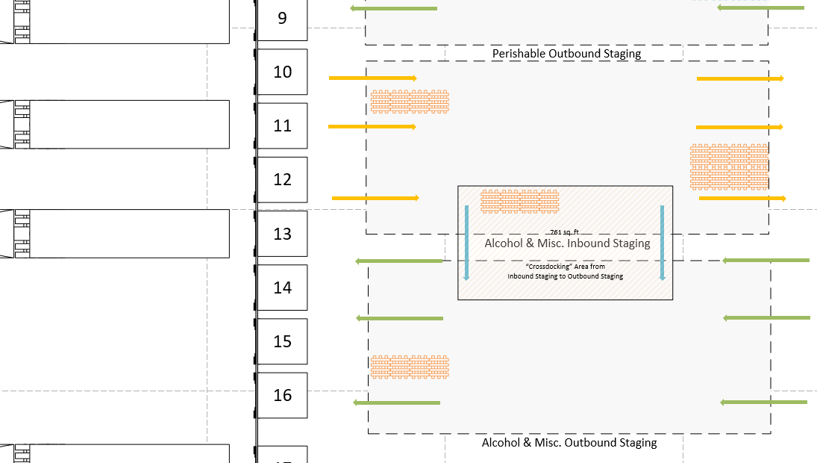
DOCK OPERATIONS
DOCK OPERATIONS

Slide 21
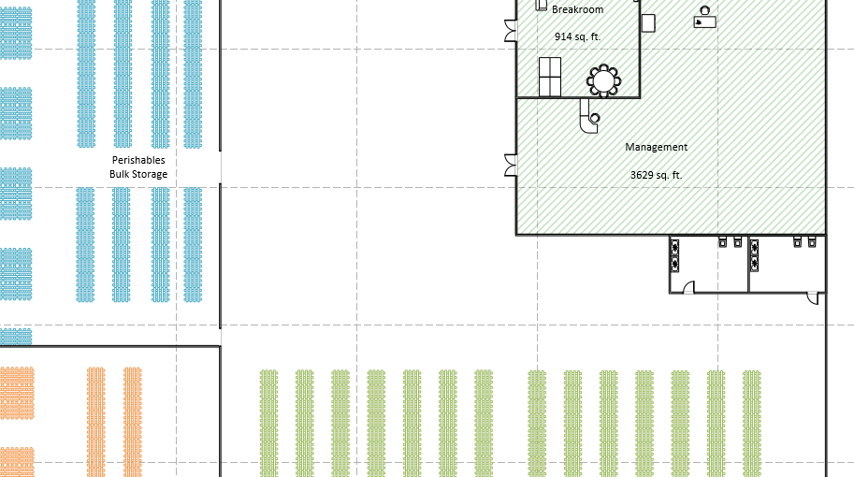
BULK STORAGE & MANAGEMENT
BULK STORAGE & MANAGEMENT

Slide 22
COST ANALYSIS
Department | Current Warehouse (No.of Employee) | New Warehouse (No. Of Employee) | Yearly Hours | Hourly Cost($/hr) | Total ($)
Recieving | 17 | 12 | 3285 | 31.5 | 1,231,875
Putaway/ Replenishment | 12 | 8 | 3285 | 31.5 | 821,250
Order Selectors | 50 | 35 | 3285 | 29.5 | 3,391,763
Inventory Management | 5 | 4 | 3285 | 31.25 | 410,625
Administration | 7 | 5 | 3285 | 31.25 | 513,281
Maintenance | 9 | 7 | 2555 | 27.5 | 496,309
Total (Yearly) | 100 | 71 |  |  | 6,865,103
W-14 consisted of 100 employee for almost 100% of space utilization. 20% of slow-moving goods have already been transferred to Direct to Store
Based on the new design and consideration, we have assumed 70% of space utilization. Total employee=71 and their yearly cost for employees only.

Slide 23
EMPLOYEE ADDITION & MATERIAL HANDLING
The employee will be only added in future if there is dire need. Else, introduction of more automatic system in future to compensate.
01
Narrow aisle Straddle Truck- 8 feet aisle width; capcities upto 4000 lb
02
Reach truck- can carry upto 2000 lbs (very good for rack storage and reach upto 45 feet high).
03

Slide 24
BASELINE VS. 2024
5.5% annual growth is estimated and compunded till 2024.
Calculations were done for 2015 and 2024 and the final data is corresponding to the 2024.
20% of the slow-moving products from current warehouse are shifted to direct to store system in new warehouse.
9 new products from 2015 warehouse inventory is shifted to crossdocking in new warehouse.

Slide 25
ADDITIONAL RECOMMENDATIONS
Record keeping for the inventory data needs to be improved
Demand analysis should be done for each warehouse such that depending upon the type of product, it can be shifted to either cross docking or direct to store.
AGVs and ASRS systems can be introduced for material handling in near future.
The road regulations restricts the efficient warehouse building. So in future, FFN need to find locations with flexible regulations.

Slide 26

Thank you
Samantha Huckabay, Seng Hooi Lim,
Abhimanyu Sah, Devarshi Tharwala

Slide 27
References
http://www.isye.gatech.edu/~spyros/courses/IE6202/Design+Control.ppt
http://www.mhi.org/
Google Images
https://raymondhandling.com/dictionary/narrow-aisle-truck/
https://raymondhandling.com/dictionary/narrow-aisle-truck/

